Slide 1


K.RAMAKRISHNAN COLLEGE OF TECHNOLOGY
(AUTONOMOUS), TRICHY.
CITY GUIDE PROJECT
PRESENTED
DURGA R
2303811720422036
SUPERVISOR
Mr. M. Saravanan, M.E.,
AP/CSE.
Notes:
1

Slide 2
PRESENTATION OVERVIEW
Objective
Project Introduction
Problem Statement
Methodologies (Programming concepts relevant to problem statement)
Architecture of the proposed system
List of Modules
Merits
Results and Discussion
Queries
Notes:
2

Slide 3
OBJECTIVE
To create a comprehensive and user-friendly city guide that provides residents and visitors with essential information about the city, including attractions, dining, accommodation, transportation, events, and local culture, fostering a deeper connection with the city and enhancing the overall experience.
Notes:
3

Slide 4
PROJECT INTRODUCTION
Exploring a city, whether as a resident or a visitor, can be an exciting yet overwhelming experience. With countless attractions, diverse dining options, vibrant neighborhoods, and unique cultural events, navigating through the multitude of choices can be challenging. This city guide aims to simplify that journey by providing a curated, comprehensive resource tailored to help users make the most of their time in the city.
Notes:
4

Slide 5
PROBLEM STATEMENT
Cities are dynamic and diverse, offering countless attractions, activities, and experiences. However, for both residents and visitors, finding reliable, up-to-date, and well-organized information about a city's offerings can be challenging. Many existing resources are fragmented, outdated, or fail to cater to the specific needs of different users, such as tourists, locals, or business travelers.
Notes:
5

Slide 6
METHODOLOGIES
1. Research: Gather data through surveys, interviews, field visits, and analysis of existing resources to ensure accurate and relevant information. 2. Content Development: Curate and categorize content, highlighting attractions, dining, transportation, and local insights. 3. User-Centric Design: Develop an intuitive interface with interactive maps, multimedia elements, and accessibility features.
Notes:
6

Slide 7
4. Technology Integration: Implement real-time updates, location-based recommendations, and mobile app functionality. 5. Testing and Feedback: Test prototypes with users and refine based on feedback. 6. Launch and Marketing: Promote through social media, partnerships, and a soft launch for initial feedback. 7. Continuous Updates: Regularly update the guide to maintain accuracy and relevance.

Slide 8
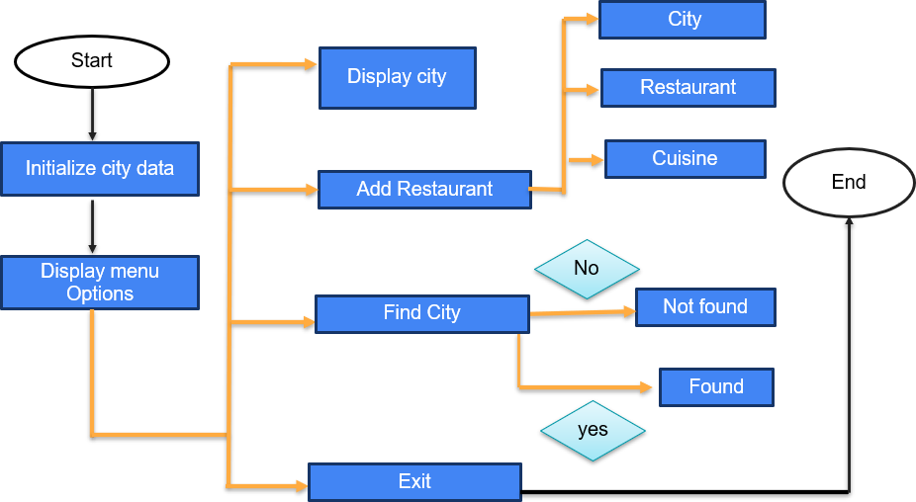
ARCHITECTURE OF THE PROPOSED SYSTEM
Notes:
8

Slide 9
LIST OF MODULES
User Interface Module: Input fields for entering city names, restaurant names, and cuisine types. Buttons for performing actions such as displaying city details, adding a restaurant and finding a city. Output area for displaying results, error messages, or success messages. City Management Module: Predefined city initialization with restaurant data. Methods to add restaurants dynamically. Validation to ensure cities are unique and properly managed in the application.
Restaurant Management Module: Methods for adding restaurants to existing cities. To manage restaurant details within each city. Capability to view all restaurants and their cuisine types in a selected city.
Notes:
9

Slide 10
Data Validation Module: Validating user inputs, such as checking if a city exists before adding a restaurant. Handling edge cases, such as duplicate restaurant names or missing data. Displaying appropriate error or success messages to guide user actions. Predefined Data Initialization Module: Initializing cities like Chennai, Coimbatore, Madurai, and Trichy with their respective restaurants and cuisines. Ensuring the predefined data serves as a functional starting point for user exploration. To populate the application with initial data for predefined cities and restaurants.

Slide 11
MERITS
1. Enhanced User Experience
2. Time and Effort Saving
3. Promotes Local Businesses
4. Tourism Growth
5. Improved City Navigation
Notes:
11

Slide 12
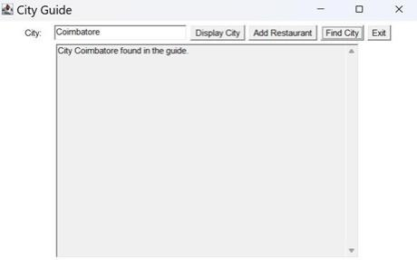
RESULTS AND DISCUSSION
Notes:
12

Slide 13
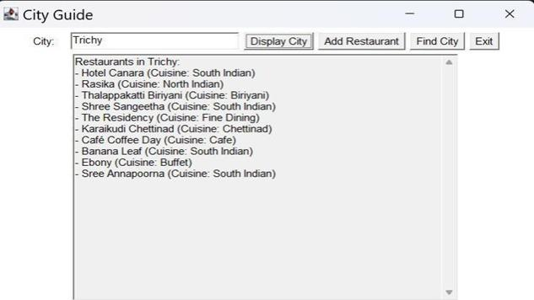

Slide 14
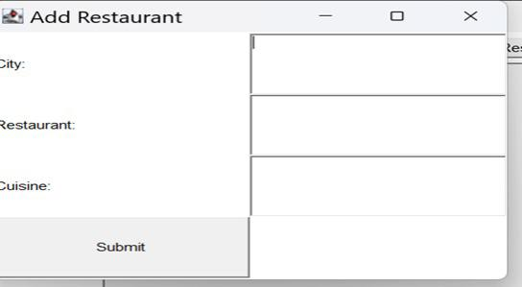

Slide 15
QUERIES ?
Notes:
15

